Slide 1


Enterprise Device Training Guide
ED

Slide 2
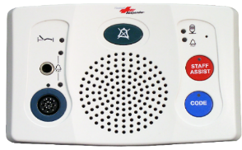
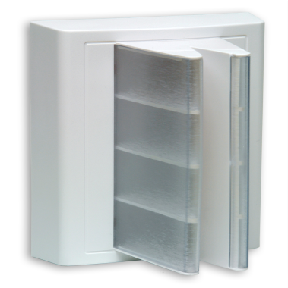




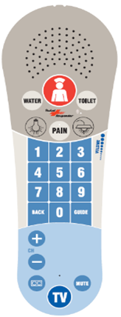




SFI: ENTERPRISE DEVICES – ED
ENHANCED PATIENT STATION
Cancel Button
Auxiliary Jack
For a specialty call cord (touch pad, squeeze ball, etc.) It will initiate a patient call
Staff Assist Button
Staff will press this button to initiate an urgent alert
Flashing Lights
Fast Ding
Code Blue
Staff will press this button to initiate an urgent alert
Fast Cascade Lights
Warble
PILLOW SPEAKER
Cord Out / Plug out
Occurs when the Pillow Speaker or Call Cord has been removed
IF STAFF WANT TO REMOVE ANY CORD FROM THE PATIENT STATION AND NOT INITIATE AN ALARM.
UNPLUG THE DEVICE
PRESS THE CANCEL BUTTON WITHIN 5 SECONDS
Flashing Light
Medium Ding
5 sec grace
PILLOW SPEAKER
Patient
Water
Need Toilet
In Pain
Flashing Lights
Slow Ding
Flashing Light
Slow Ding
Flashing Lights
Slow Ding
Overhead
Light Controls
Flashing Lights
Slow Ding
TV Controls

Slide 3
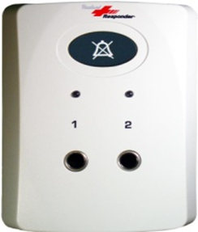




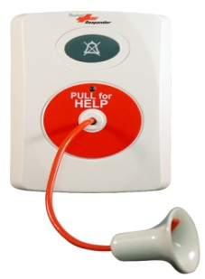
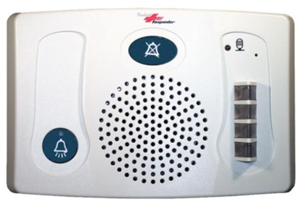



SFI: ENTERPRISE DEVICES
ED
2-JACK AUXILIARY JACK STATION
Cancel Button
Chair Alarm
Console – Immediately
Chair Alarm
Console – Immediately
Flashing Light
Fast Ding
Flashing Lights
Fast Ding
Cord Out
IF STAFF WANT TO REMOVE ANY CORD FROM THE PATIENT STATION AND NOT INITIATE AN ALARM.
UNPLUG THE DEVICE
PRESS THE CANCEL BUTTON WITHIN 5 SECONDS
Flashing Light
Medium Ding
5 sec grace
PATIENT BATHROOM PULL CORD
DUTY STATION
Cancel Button
Cancel Button
Call Button – Staff can place a call to the Master Console
Dome Lights –
Mimics highest priority active call light
Toilet
Console – Immediately
Flashing Lights
Fast Ding
6/8/2023

Slide 4
Enterprise Device Training Guide
Imaging

Slide 5
SFI: ENTERPRISE DEVICES – Imaging
ENHANCED PATIENT STATION
Cancel Button
Auxiliary Jack
For a specialty call cord (touch pad, squeeze ball, etc.) It will initiate a patient call
Staff Assist Button
Staff will press this button to initiate an urgent alert
Flashing Lights
Fast Ding
Code Blue
Staff will press this button to initiate an urgent alert
Fast Cascade Lights
Warble
PILLOW SPEAKER
Cord Out / Plug out
Occurs when the Pillow Speaker or Call Cord has been removed
IF STAFF WANT TO REMOVE ANY CORD FROM THE PATIENT STATION AND NOT INITIATE AN ALARM.
UNPLUG THE DEVICE
PRESS THE CANCEL BUTTON WITHIN 5 SECONDS
Flashing Light
Medium Ding
5 sec grace
PILLOW SPEAKER
Patient
Water
Need Toilet
In Pain
Flashing Lights
Slow Ding
Flashing Light
Slow Ding
Flashing Lights
Slow Ding
Overhead
Light Controls
Flashing Lights
Slow Ding
TV Controls

Slide 6
SFI: ENTERPRISE DEVICES
IMAGING
DUAL PUSH BUTTON
STATION
Cancel Button
Rapid Response Button
Staff will press this button to initiate an urgent alert
Flashing Lights
Fast Ding
Code Blue
Staff will press this button to initiate an urgent alert
Fast Cascading Lights
Warble
PATIENT BATHROOM PULL CORD
DUTY STATION
Cancel Button
Cancel Button
Call Button – Staff can place a call to the Master Console
Dome Lights –
Mimics highest priority active call light
Toilet
Console – Immediately
Flashing Lights
Fast Ding
6/8/2023

Slide 7
Enterprise Device Training Guide
2 South

Slide 8
SFI: ENTERPRISE DEVICES – 2 South
ENHANCED PATIENT STATION
Cancel Button
Auxiliary Jack
For a specialty call cord (touch pad, squeeze ball, etc.) It will initiate a patient call
Staff Assist Button
Staff will press this button to initiate an urgent alert
Flashing Lights
Fast Ding
Code Blue
Staff will press this button to initiate an urgent alert
Fast Cascade Lights
Warble
PILLOW SPEAKER
Cord Out / Plug out
Occurs when the Pillow Speaker or Call Cord has been removed
IF STAFF WANT TO REMOVE ANY CORD FROM THE PATIENT STATION AND NOT INITIATE AN ALARM.
UNPLUG THE DEVICE
PRESS THE CANCEL BUTTON WITHIN 5 SECONDS
Flashing Light
Medium Ding
5 sec grace
PILLOW SPEAKER
Patient
Water
Need Toilet
In Pain
Flashing Lights
Slow Ding
Flashing Light
Slow Ding
Flashing Lights
Slow Ding
Overhead
Light Controls
Flashing Lights
Slow Ding
TV Controls

Slide 9
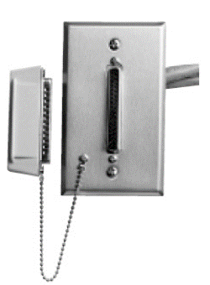



SFI: ENTERPRISE DEVICES – 2 South
2-JACK AUXILIARY JACK STATION
Cancel Button
Chair Alarm
Console – Immediately
Chair Alarm
Console – Immediately
Flashing Light
Fast Ding
Flashing Lights
Fast Ding
Cord Out
Occurs when the Call Cord has been removed
IF STAFF WANT TO REMOVE ANY CORD FROM THE PATIENT STATION AND NOT INITIATE AN ALARM.
UNPLUG THE DEVICE
PRESS THE CANCEL BUTTON WITHIN 5 SECONDS
Flashing Light
Medium Ding
5 sec grace
FEATURE BED MODULE
Bed Out
Occurs when the Feature Bed plug has been removed
Console – After 5 seconds
Bed Exit
Occurs when the alarm on the bed is initiated
Console – Immediately
Flashing Light
Medium Ding
5 sec grace
Flashing Lights
Fast Ding
Clear the alarm on the bed then use the cancel button on the Patient Station to clear the alert
IF STAFF WANT TO REMOVE ANY CORD FROM THE PATIENT STATION AND NOT INITIATE AN ALARM.
UNPLUG THE DEVICE
PRESS THE CANCEL BUTTON WITHIN 5 SECONDS
Dummy Plug – Insert the dummy plug to protect the bed connection

Slide 10
SFI: ENTERPRISE DEVICES – 2 South
PATIENT BATHROOM PULL CORD
DUTY STATION
Cancel Button
Cancel Button
Call Button – Staff can place a call to the Master Console
Dome Lights –
Mimics highest priority active call light
Toilet
Console – Immediately
Flashing Lights
Medium Ding
6/8/2023

Slide 11
Enterprise Device Training Guide
3 South

Slide 12
SFI: ENTERPRISE DEVICES – 3 South
ENHANCED PATIENT STATION
Cancel Button
Auxiliary Jack
For a specialty call cord (touch pad, squeeze ball, etc.) It will initiate a patient call
Staff Assist Button
Staff will press this button to initiate an urgent alert
Flashing Lights
Fast Ding
Code Blue
Staff will press this button to initiate an urgent alert
Fast Cascade Lights
Warble
PILLOW SPEAKER
Cord Out / Plug out
Occurs when the Pillow Speaker or Call Cord has been removed
IF STAFF WANT TO REMOVE ANY CORD FROM THE PATIENT STATION AND NOT INITIATE AN ALARM.
UNPLUG THE DEVICE
PRESS THE CANCEL BUTTON WITHIN 5 SECONDS
Flashing Light
Medium Ding
5 sec grace
PILLOW SPEAKER
Patient
Water
Need Toilet
In Pain
Flashing Lights
Slow Ding
Flashing Light
Slow Ding
Flashing Lights
Slow Ding
Overhead
Light Controls
Flashing Lights
Slow Ding
TV Controls

Slide 13
SFI: ENTERPRISE DEVICES – 3 South
2-JACK AUXILIARY JACK STATION
Cancel Button
Chair Alarm
Console – Immediately
Chair Alarm
Console – Immediately
Flashing Light
Fast Ding
Flashing Lights
Fast Ding
Cord Out
Occurs when the Call Cord has been removed
IF STAFF WANT TO REMOVE ANY CORD FROM THE PATIENT STATION AND NOT INITIATE AN ALARM.
UNPLUG THE DEVICE
PRESS THE CANCEL BUTTON WITHIN 5 SECONDS
Flashing Light
Medium Ding
5 sec grace
FEATURE BED MODULE
Bed Out
Occurs when the Feature Bed plug has been removed
Console – After 5 seconds
Bed Exit
Occurs when the alarm on the bed is initiated
Console – Immediately
Flashing Light
Medium Ding
5 sec grace
Flashing Lights
Fast Ding
Clear the alarm on the bed then use the cancel button on the Patient Station to clear the alert
IF STAFF WANT TO REMOVE ANY CORD FROM THE PATIENT STATION AND NOT INITIATE AN ALARM.
UNPLUG THE DEVICE
PRESS THE CANCEL BUTTON WITHIN 5 SECONDS
Dummy Plug – Insert the dummy plug to protect the bed connection

Slide 14
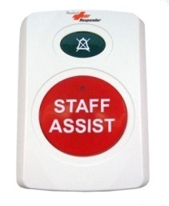
SFI: ENTERPRISE DEVICES – 3 South
PATIENT BATHROOM PULL CORD
DUTY STATION
Cancel Button
Cancel Button
Call Button – Staff can place a call to the Master Console
Dome Lights –
Mimics highest priority active call light
Toilet
Console – Immediately
Flashing Lights
Medium Ding
Staff Assist Button
Staff will press this button to initiate an urgent alert
STAFF ASSIST BUTTON
STATION
Cancel Button
Fast Cascading Lights
Fast Ding
6/8/2023

Slide 15
Enterprise Device Training Guide
3 North

Slide 16
SFI: ENTERPRISE DEVICES – 3 North
ENHANCED PATIENT STATION
Cancel Button
Auxiliary Jack
For a specialty call cord (touch pad, squeeze ball, etc.) It will initiate a patient call
Staff Assist Button
Staff will press this button to initiate an urgent alert
Flashing Lights
Fast Ding
Code Blue
Staff will press this button to initiate an urgent alert
Fast Cascade Lights
Warble
PILLOW SPEAKER
Cord Out / Plug out
Occurs when the Pillow Speaker or Call Cord has been removed
IF STAFF WANT TO REMOVE ANY CORD FROM THE PATIENT STATION AND NOT INITIATE AN ALARM.
UNPLUG THE DEVICE
PRESS THE CANCEL BUTTON WITHIN 5 SECONDS
Flashing Light
Medium Ding
5 sec grace
PILLOW SPEAKER
Patient
Water
Need Toilet
In Pain
Flashing Lights
Slow Ding
Flashing Light
Slow Ding
Flashing Lights
Slow Ding
Overhead
Light Controls
Flashing Lights
Slow Ding
TV Controls

Slide 17
SFI: ENTERPRISE DEVICES – 3 North
2-JACK AUXILIARY JACK STATION
Cancel Button
Chair Alarm
Console – Immediately
Chair Alarm
Console – Immediately
Flashing Light
Fast Ding
Flashing Lights
Fast Ding
Cord Out
Occurs when the Call Cord has been removed
IF STAFF WANT TO REMOVE ANY CORD FROM THE PATIENT STATION AND NOT INITIATE AN ALARM.
UNPLUG THE DEVICE
PRESS THE CANCEL BUTTON WITHIN 5 SECONDS
Flashing Light
Medium Ding
5 sec grace
FEATURE BED MODULE
Bed Out
Occurs when the Feature Bed plug has been removed
Console – After 5 seconds
Bed Exit
Occurs when the alarm on the bed is initiated
Console – Immediately
Flashing Light
Medium Ding
5 sec grace
Flashing Lights
Fast Ding
Clear the alarm on the bed then use the cancel button on the Patient Station to clear the alert
IF STAFF WANT TO REMOVE ANY CORD FROM THE PATIENT STATION AND NOT INITIATE AN ALARM.
UNPLUG THE DEVICE
PRESS THE CANCEL BUTTON WITHIN 5 SECONDS
Dummy Plug – Insert the dummy plug to protect the bed connection

Slide 18
SFI: ENTERPRISE DEVICES – 3 North
PATIENT BATHROOM PULL CORD
DUTY STATION
Cancel Button
Cancel Button
Call Button – Staff can place a call to the Master Console
Dome Lights –
Mimics highest priority active call light
Toilet
Console – Immediately
Flashing Lights
Medium Ding
STAFF ASSIST BUTTON
STATION
Staff Assist Button
Staff will press this button to initiate an urgent alert
Cancel Button
Fast Cascading Lights
Fast Ding
6/8/2023

Slide 19
Enterprise Device Training Guide
OR

Slide 20
SFI: ENTERPRISE DEVICES – OR
DUAL PUSH BUTTON
STATION
Cancel Button
Staff Assist Button
Staff will press this button to initiate an urgent alert
Fast Cascading Lights
Fast Ding
Code Blue
Staff will press this button to initiate an urgent alert
Fast Cascading Lights
Warble
DUTY STATION
Cancel Button
Call Button – Staff can place a call to the Master Console
Dome Lights –
Mimics highest priority active call light
6/8/2023

Slide 21
Enterprise Device Training Guide
4PRE

Slide 22
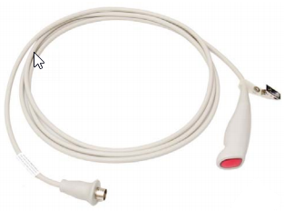
SFI: ENTERPRISE DEVICES – 4PRE
ENHANCED PATIENT STATION
Cancel Button
Auxiliary Jack
For a specialty call cord (touch pad, squeeze ball, etc.) It will initiate a patient call
Rapid Response Button
Staff will press this button to initiate an urgent alert
Flashing Lights
Fast Ding
Code Blue
Staff will press this button to initiate an urgent alert
Fast Cascade Lights
Warble
CALL CORD
Cord Out / Plug out
Occurs when the Pillow Speaker or Call Cord has been removed
IF STAFF WANT TO REMOVE ANY CORD FROM THE PATIENT STATION AND NOT INITIATE AN ALARM.
UNPLUG THE DEVICE
PRESS THE CANCEL BUTTON WITHIN 5 SECONDS
Flashing Light
Medium Ding
5 sec grace
CALL CORD
Patient
Flashing Light
Slow Ding

Slide 23
SFI: ENTERPRISE DEVICES – 4PRE
PATIENT BATHROOM PULL CORD
DUTY STATION
Cancel Button
Cancel Button
Call Button – Staff can place a call to the Master Console
Dome Lights –
Mimics highest priority active call light
Toilet
Console – Immediately
Flashing Lights
Medium Ding
6/8/2023

Slide 24
Enterprise Device Training Guide
4PAC

Slide 25
SFI: ENTERPRISE DEVICES – 4PAC
ENHANCED PATIENT STATION
Cancel Button
Auxiliary Jack
For a specialty call cord (touch pad, squeeze ball, etc.) It will initiate a patient call
Rapid Response Button
Staff will press this button to initiate an urgent alert
Flashing Lights
Fast Ding
Code Blue
Staff will press this button to initiate an urgent alert
Fast Cascade Lights
Warble
CALL CORD
Cord Out / Plug out
Occurs when the Pillow Speaker or Call Cord has been removed
IF STAFF WANT TO REMOVE ANY CORD FROM THE PATIENT STATION AND NOT INITIATE AN ALARM.
UNPLUG THE DEVICE
PRESS THE CANCEL BUTTON WITHIN 5 SECONDS
Flashing Light
Medium Ding
5 sec grace
CALL CORD
Patient
Flashing Light
Slow Ding

Slide 26
SFI: ENTERPRISE DEVICES – 4PAC
PATIENT BATHROOM PULL CORD
DUTY STATION
Cancel Button
Cancel Button
Call Button – Staff can place a call to the Master Console
Dome Lights –
Mimics highest priority active call light
Toilet
Console – Immediately
Flashing Lights
Medium Ding
6/8/2023

